Slide 1


Weather Analytics 2023
Made by: Navneet Patteri
ID: AF0411619

Slide 2
Abstract

Slide 3
Helps us understand how big meteorological companies analyze data to forecast weather
Through this analysis, we can conduct case studies and such about a certain location’s weather pattern
Analysis of various weather parameters for few cities in the year 2023

Slide 4

Dataset Used
What is an API?
An API from openMeteo.com
Request: You send a request to the API endpoint.
A bridge that enables one application to request and receive specific data or services from another application
Application Programming Interface
Request: The API returns the requested data, often in JSON or XML

Slide 5
Why an API?
APIs offer real-time data without any(minimum) discrepancy in it.
APIs can handle larger datasets by allowing us to retrieve necessary data from it.
APIs are secure and use authentication methods to ensure safety.
APIs ensure data consistency and reliability in the data provided b

Slide 6
Parameters Chosen

Slide 7

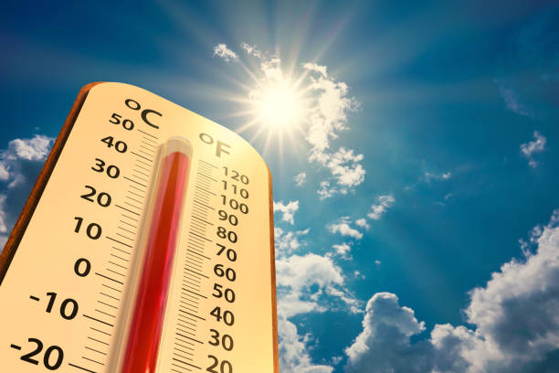

Temperature
Returns the temperature of a particular
location 2 meters above the ground. (°C)

Slide 8
Humidity
Returns the relative humidity of a particular
location 2 meters above the ground. (%)

Slide 9

Sunrise Times
Returns the time of day during which sunrise
begins. (Time format)

Slide 10
Sunset Times
Returns the time of day during which sunset
begins. (Time format)

Slide 11
Sunshine Duration
Return the total time for which sunshine lasts
in a day in seconds. (seconds)

Slide 12

Daylight Duration
Return the total time for which daylight prevails
in a day in seconds. (seconds)

Slide 13
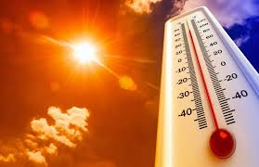
Returns the maximum temperature recorded
in a day. (°C)
Maximum Temperature

Slide 14
Returns the minimum temperature recorded
in a day. (°C)
Minimum Temperature

Slide 15
Technology Used
Python(Numpy, Pandas, Matplotlib) for basic cleaning and data manipulation
Excel – For exporting dataset
Power BI for interactive dashboards

Slide 16












Problem Statements

Slide 17
Problem 1
What are the day-to-day temperature patterns for any selected month in Delhi
(2023)?

Slide 18
Problem 2
How do the average monthly temperatures in Delhi fluctuate throughout 2023?

Slide 19
Problem 3
How do yearly temperature averages compare across various Indian cities for 2023?

Slide 20
Problem 4
What is the relationship between temperature and humidity in Delhi for 2023, and how can it be represented using a scatterplot?

Slide 21
Problem 5
How can we visualize the correlation between temperature and humidity in
Chennai for 2023 using a scatterplot?

Slide 22
Problem 6
How do sunshine and daylight hours change over the course of 2023 in Delhi?

Slide 23
Problem 7
What are the trends in sunshine and daylight duration in Chennai during 2023?

Slide 24
Problem 8
How do sunrise and sunset times shift throughout the year in Delhi (2023)?

Slide 25
Problem 9
What seasonal changes are observed in sunrise and sunset timings for Chennai
in 2023?

Slide 26
Problem 10
What are the highest and lowest temperatures recorded each month in Delhi during 2023?

Slide 27
Problem 11
How do the maximum and minimum monthly temperatures in Chennai change
over 2023?

Slide 28
Problem 12
How can the weather data be exported to an Excel file for further use or analysis?

